Slide 1
Discussion Section 8/30
SOC 110: Sociological Inquiry

Slide 2
What You Need to Know About Me
Office Hours
Thursdays by Appointment (schedule via email)
Other days can be arranged via email
Email: tom.wolff@duke.edu
Telephone: (203) 993-0680

Slide 3
Overview
Discussion is worth 15% of your grade
No Computers (per Prof. Rawlings’s request)
Participation (starting next week)
Attendance
Contributing to class discussions
Written responses to questions
Leader Group Assignments (also next week)
Student Information Survey (fill out now)
Sensitive topics (correspond via email/in person)

Slide 4
Tell Me About Yourself
What’s your name?
Where are you from?
What interests you?
Chances are there’s a sociology for that!

Slide 5
The Sociological Imagination
What is “the Sociological Imagination”?
Do you have any pet examples of using the Sociological Imagination in your life?

Slide 6
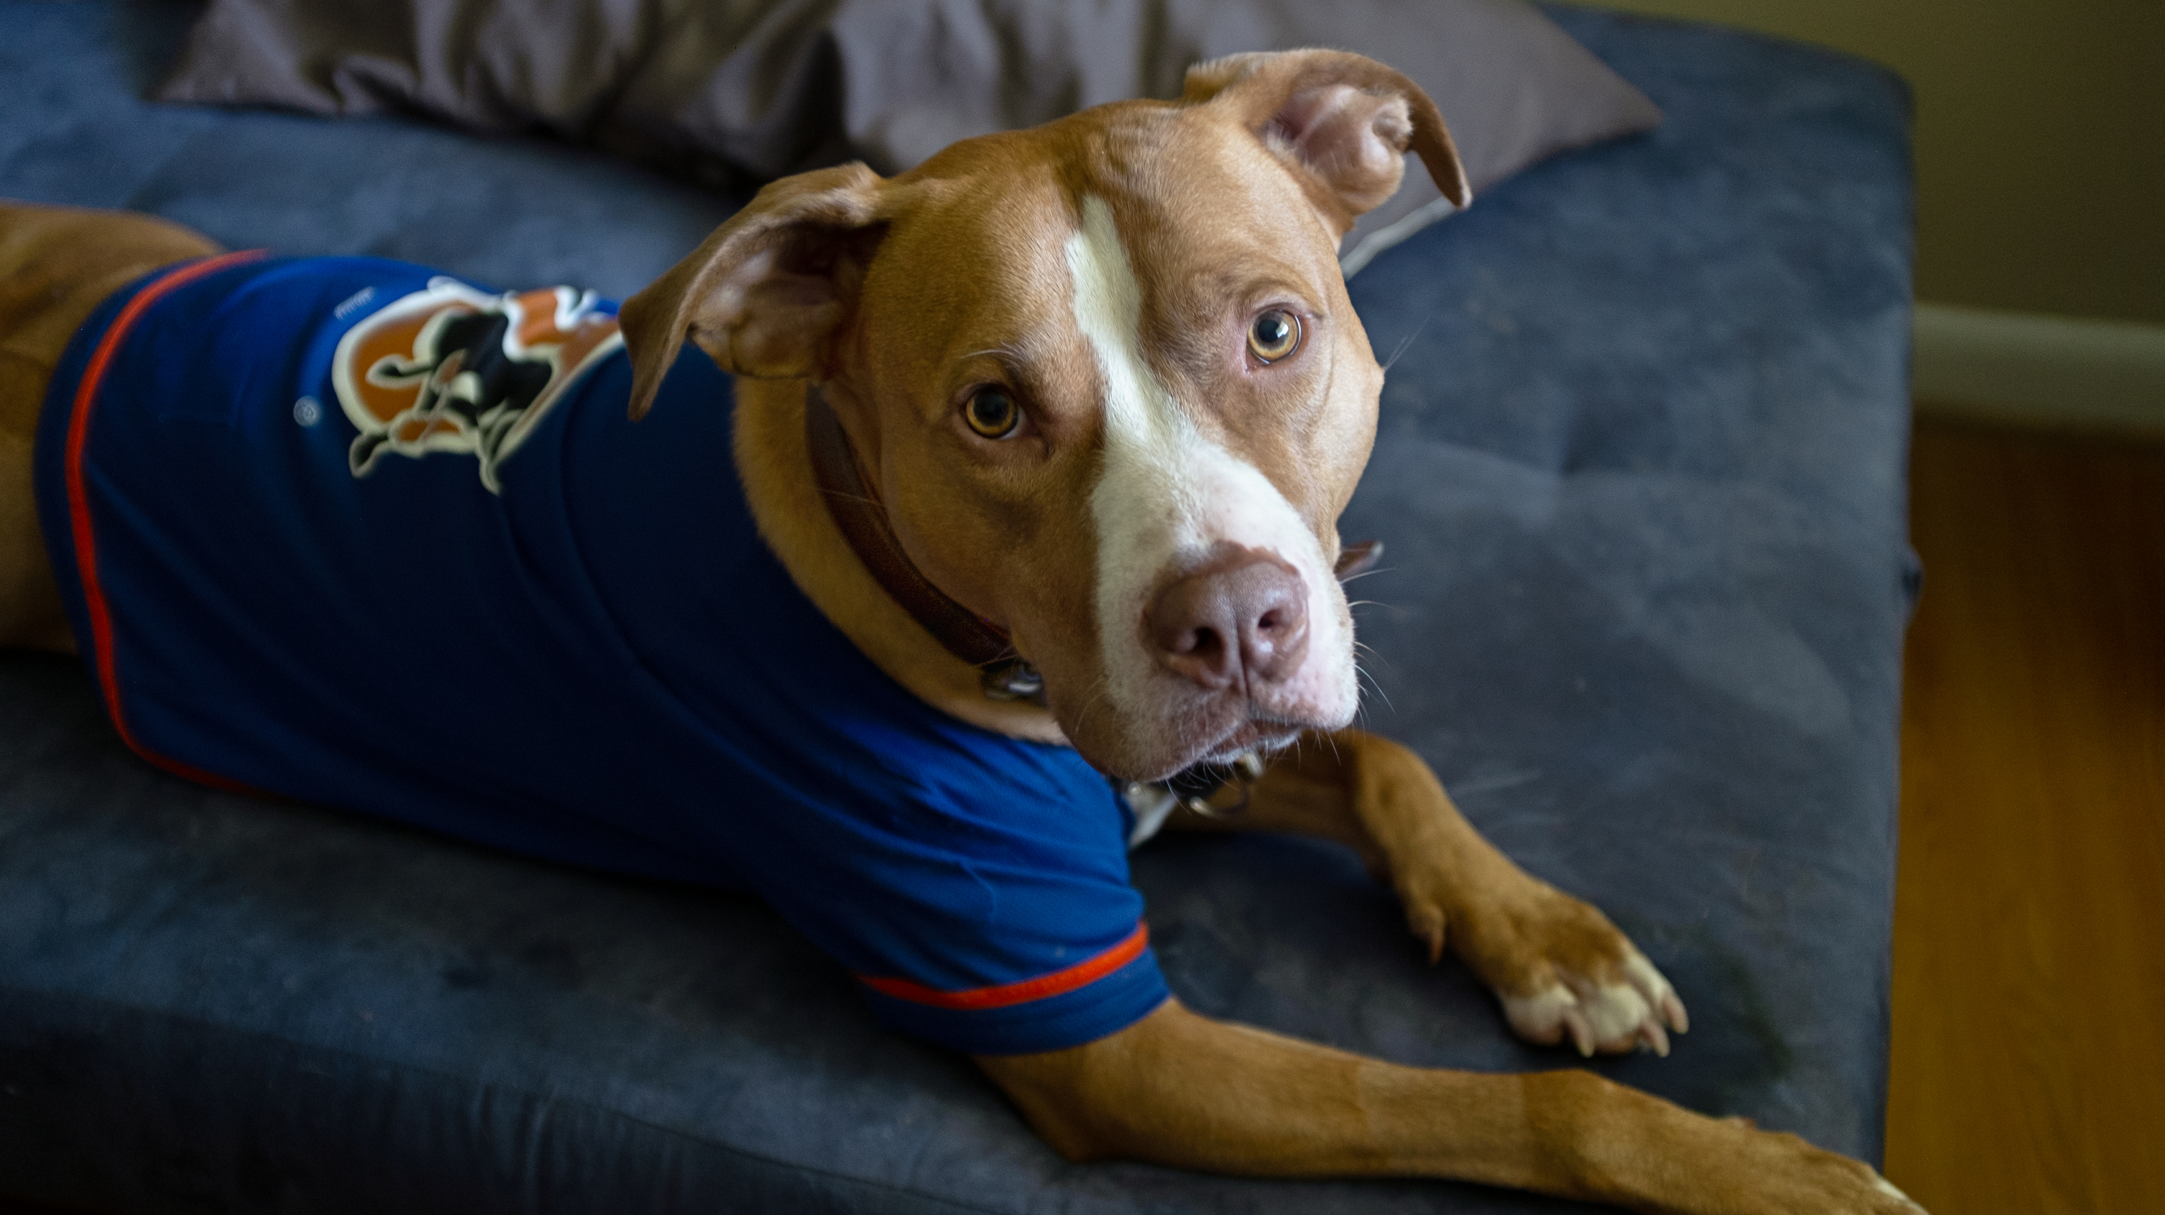
My Pet Example

Slide 7
Rituals of the Nacirema
Get it?
How does this illustrate the Sociological Imagination?
What does humor have in common with the Sociological Imagination?
How does a sociologist differ from a comedian in “making the familiar strange”?

Slide 8
Getting WEIRD With It
What does WEIRD stand for?
What challenges to WEIRD people pose to building social scientific knowledge?
How does your experience, your culture differ from those of people in other parts of the world? From different moments in history?

Slide 9
Institutions
Answer the following questions on the back of your survey:
What is an institution? (You can use your text/notes)
How would you explain this definition in your own words?
Come of with some examples of institutions. What’ the smallest one you can think of? The biggest?
How do institutions fit into one another? How do they overlap?

